Slide 1




Blowing up the bike shed with conventions
Jimmy Bogard
@jbogard
github.com/jbogard
jimmybogard.com

Slide 2
Parkinson’s Law of Triviality

Slide 3
Humans spend a great deal of time on trivial details while important matters are skipped

Slide 6
aka “Bikeshedding”

Slide 7
How do we bike shed?

Slide 8
We’re all guilty (yes you)
Class names
Class design
Folder structure
Patterns
HTML layouts
HTML widgets
Validation
SQL object names

Slide 9
These micro-decisions can derail projects!

Slide 10
Your opinion does not matter!

Slide 11
Consistency >>>>> your opinion

Slide 12
How do we enforce a standard?

Slide 13
Conventions!

Slide 14
What are conventions?

Slide 15
A set of coding policies applied and/or enforced across a codebase

Slide 16
Why should I care?

Slide 17
Survey of two projects
Project A
~6 years of development, 6-10 devs
>100 deployments to counties across Texas
ASP.NET MVC Preview 3 -> MVC 5
352 Controllers
1079 Actions
Project B
15 months of development, 6-10 devs
3 deployments to counties across Texas
78 Controllers
698 Actions

Slide 18
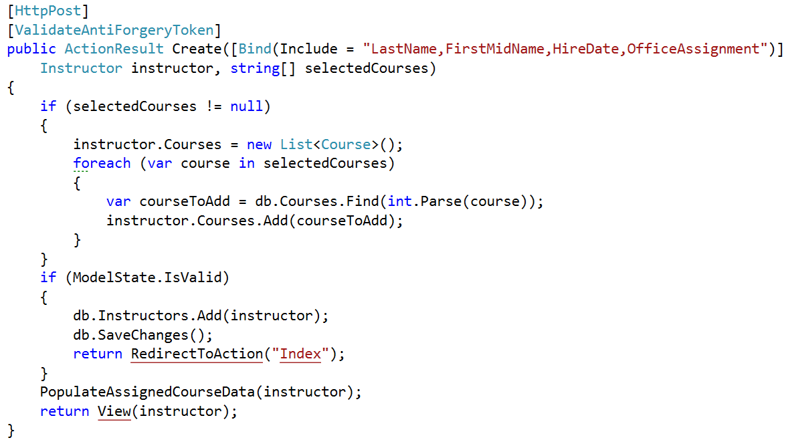
GETs/POSTs: Bad way

Slide 19
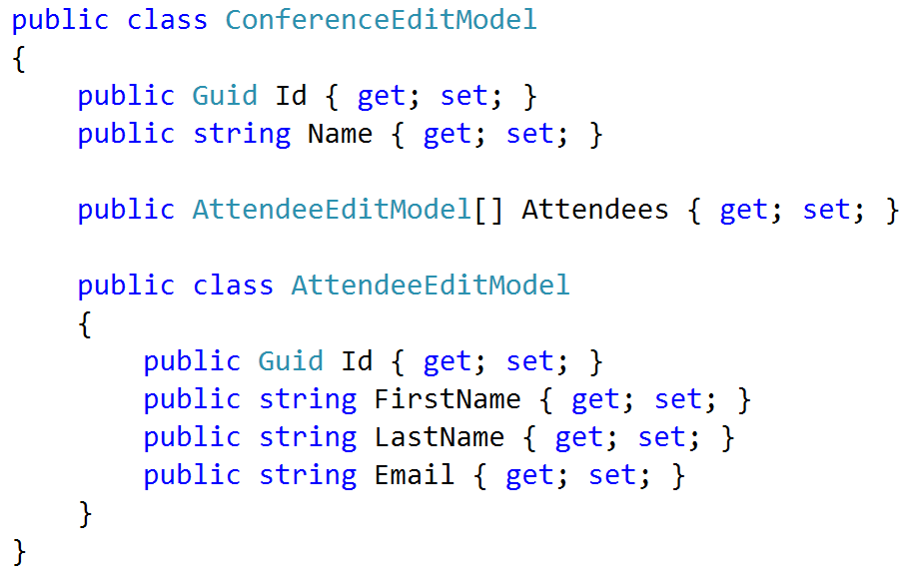
Cunning plan: View Models

Slide 20
Moment of panic
100s of controllers
100s of actions
100s of view models
100s of views

Slide 21


Slide 22
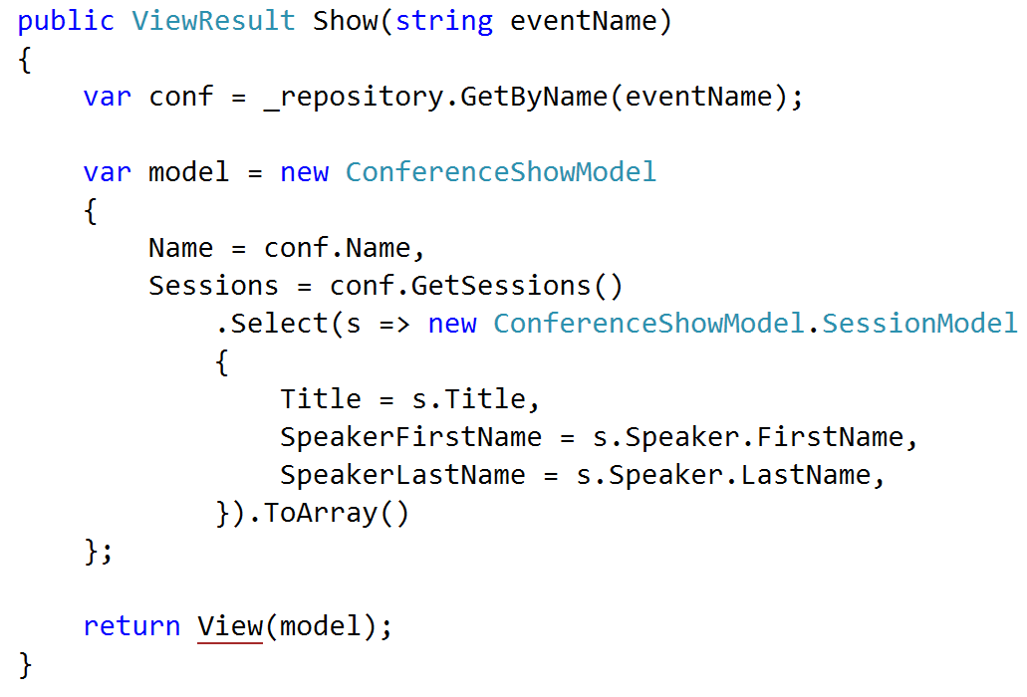
GET patterns

Slide 23
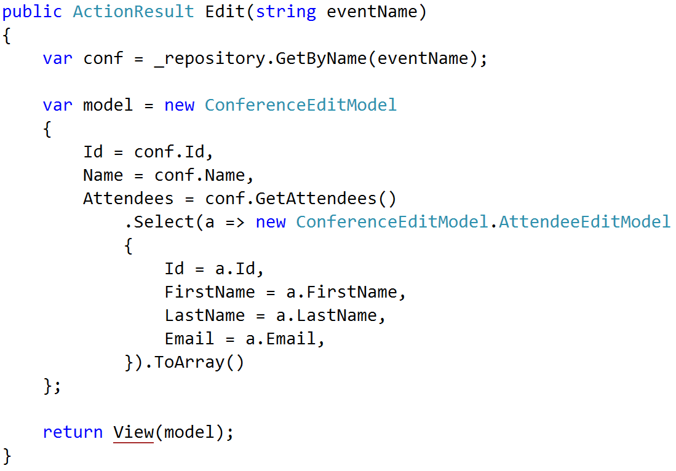
GET patterns

Slide 24
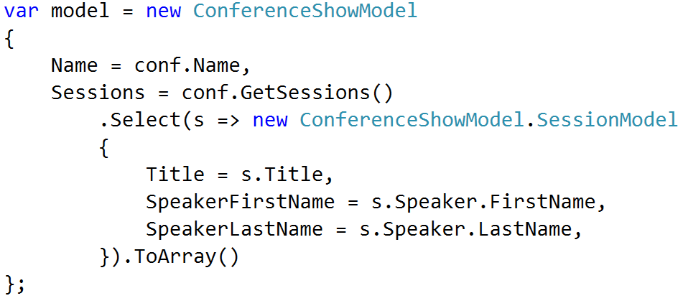
GET patterns ENHANCE

Slide 25
Policy
Match names exactly
Foo -> Foo
Bar -> Bar
Recognize Get methods
GetTotal() -> Total
Flatten navigations
Foo.Bar.Baz -> FooBarBaz
Handle the obvious

Slide 26
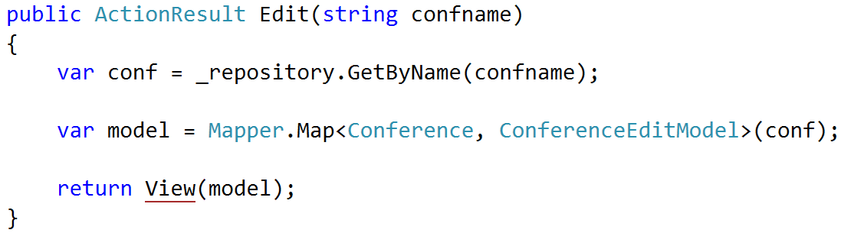
Result: AutoMapper

Slide 27
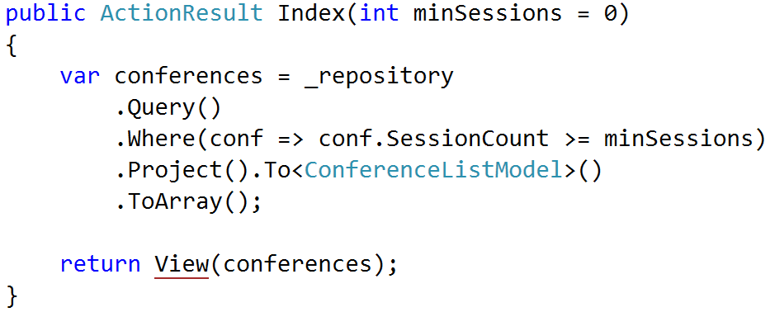
Result: AutoMapper

Slide 28
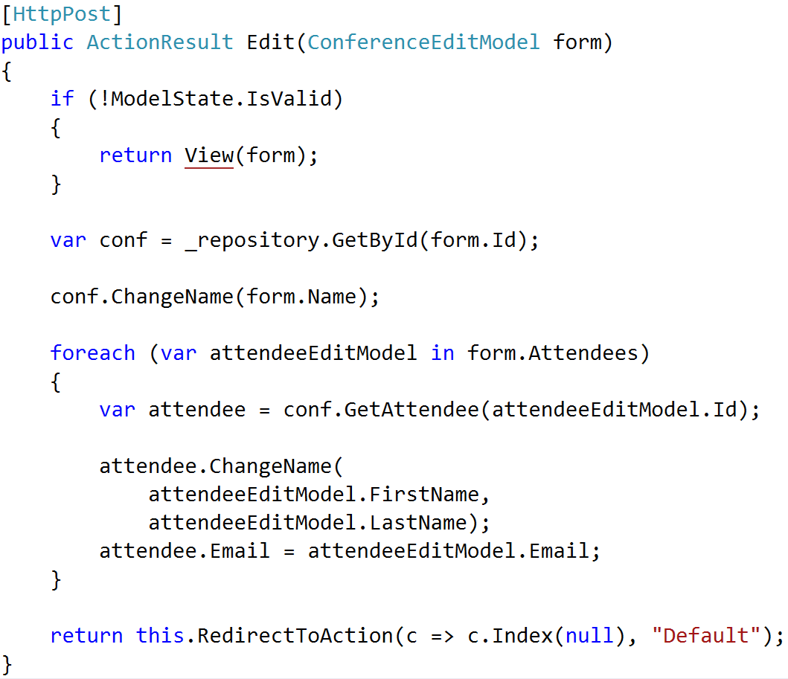
POST patterns

Slide 29
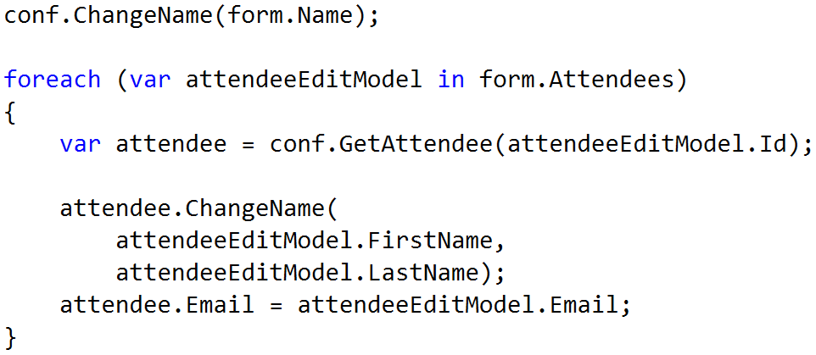
POST patterns ENHANCE

Slide 30
Policy
Behavioral entities
Logic much more complicated
No real patterns emerge
Leave it alone

Slide 31
Using Conventions

Slide 32
Implicit Conventions
Policy does not drive behavior
Policy enforced via rules
Similar to StyleCop, but one level up
Can use automated tests to enforce

Slide 33
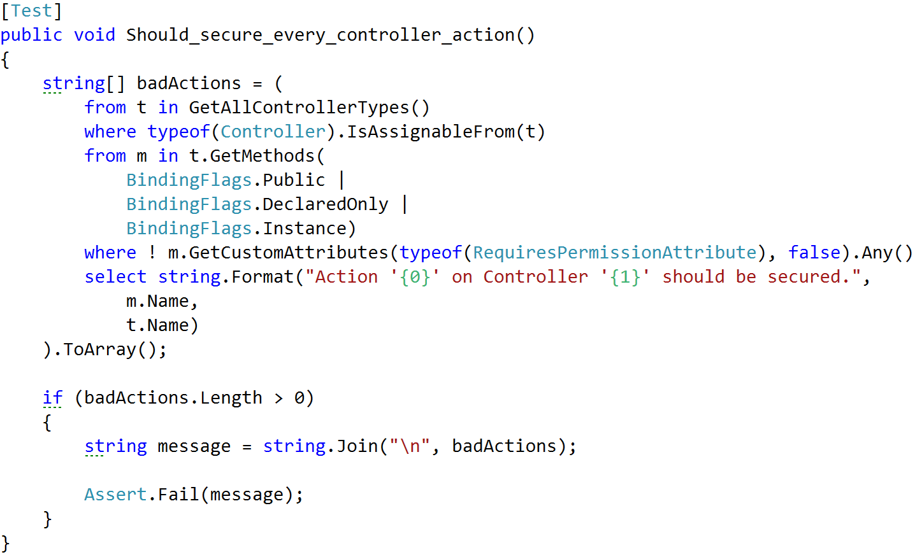
Example: Securing Actions

Slide 34
Other ideas
Type naming conventions
Controller/action names
Visibility rules
File organization

Slide 35
Explicit Conventions
Policy enforced by behavior
Opinionated rules
Customizable rules

Slide 36
Opinionated Conventions

Slide 37
Rule #1: Policies should be obvious, not magic

Slide 38
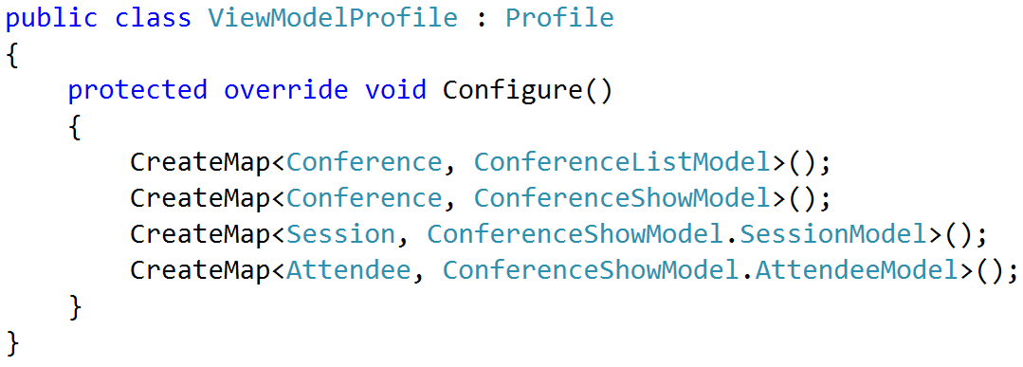
AutoMapper explicit config

Slide 39
Rule #2: Policies not driving behavior should be testable

Slide 40
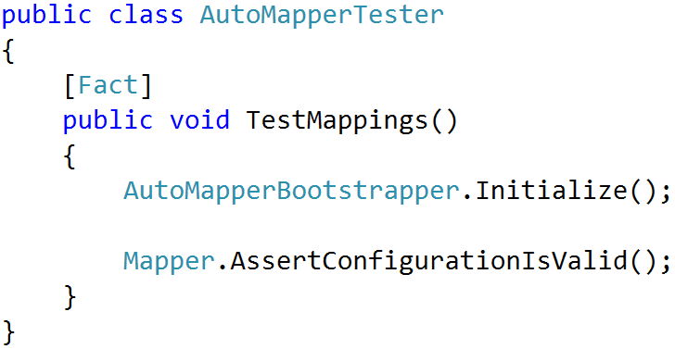
AutoMapper config validation

Slide 41
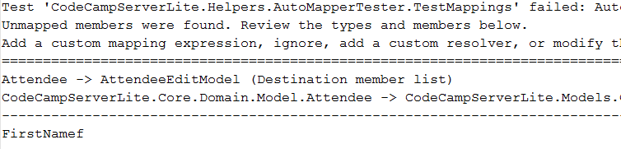
Rules violation

Slide 42
Rule #3: Policies should be debuggable

Slide 43
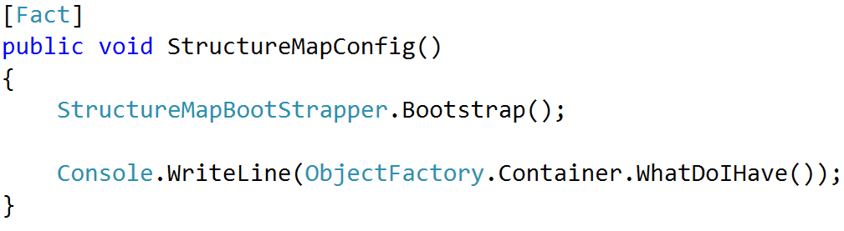
Examining StructureMap config

Slide 44
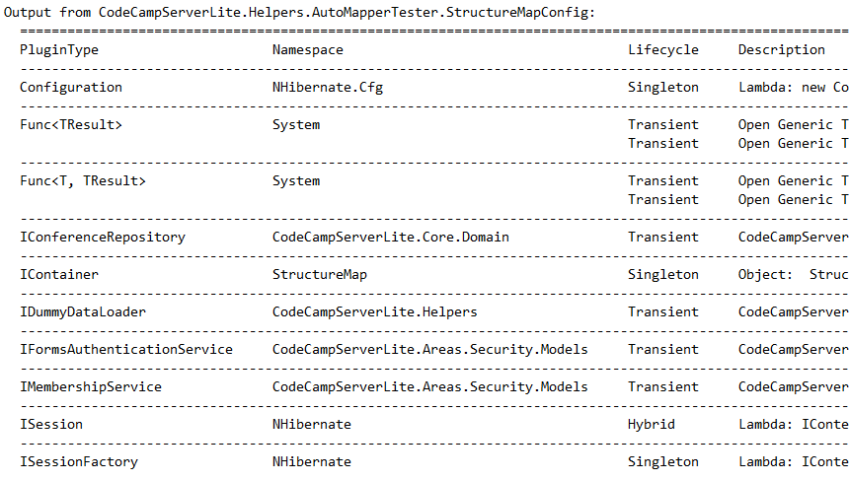
StructureMap config output

Slide 45
Real Example: HTML Conventions

Slide 46
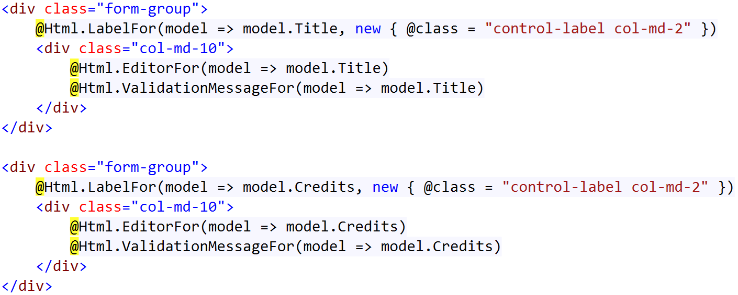
Problem: Dumb, repetitive code

Slide 47
Not a solution: templated helpers
Not easily composable
Not easily extensible
Not easily modifiable
Not code-centric

Slide 48
Solution: HTML Conventions
Element Request

Slide 49
Solution: HTML Conventions
Element Request
Policies

Slide 50
Solution: HTML Conventions
Element Request
Policies
Tag Model

Slide 51
Solution: HTML Conventions
Element Request
Policies
Tag Model
String

Slide 52
Goal

Slide 53
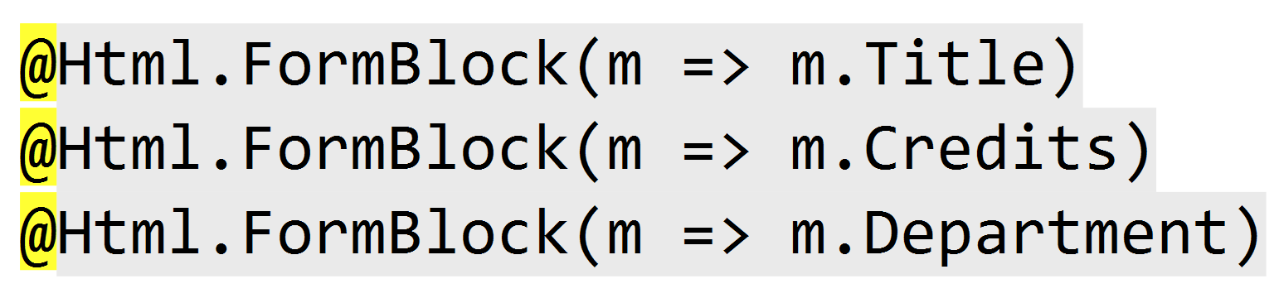
Goal

Slide 54
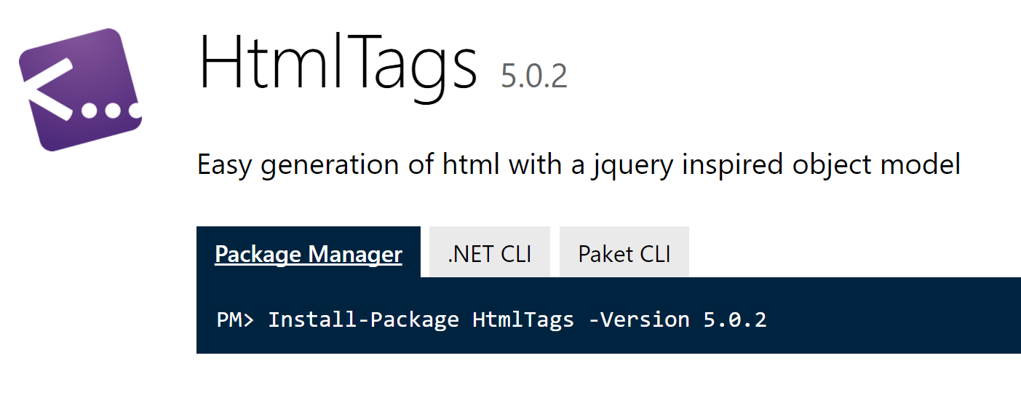
Tooling
Razor views
HtmlTag library for tag model
HtmlTag library for tag conventions

Slide 55
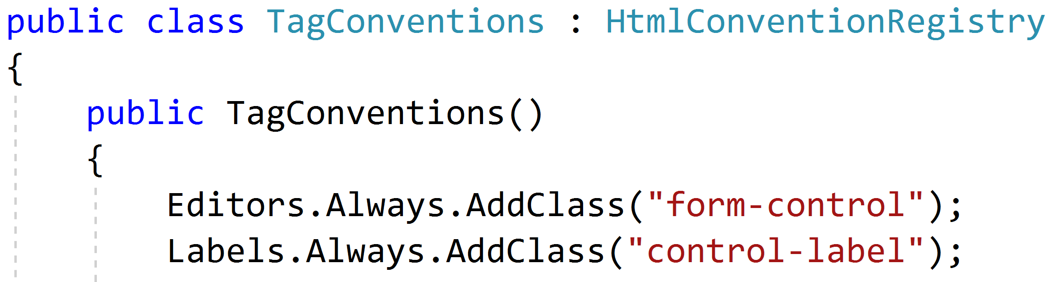
Establishing a baseline

Slide 56
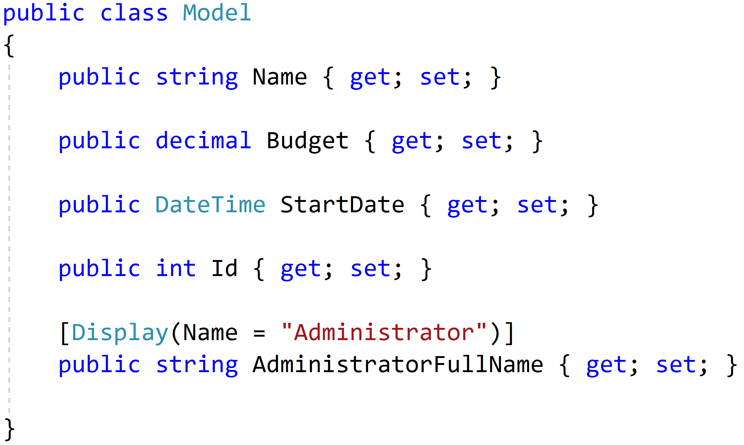
Sensible Defaults (Labels)

Slide 57
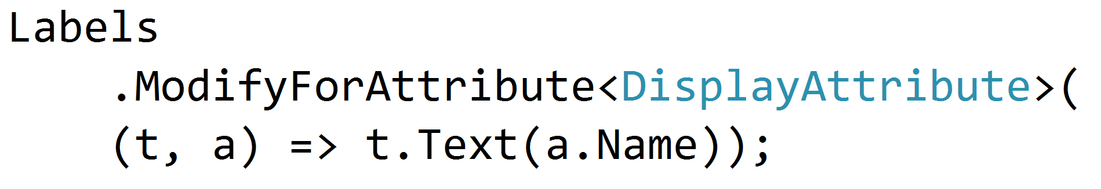
Sensible Defaults (Labels)

Slide 58
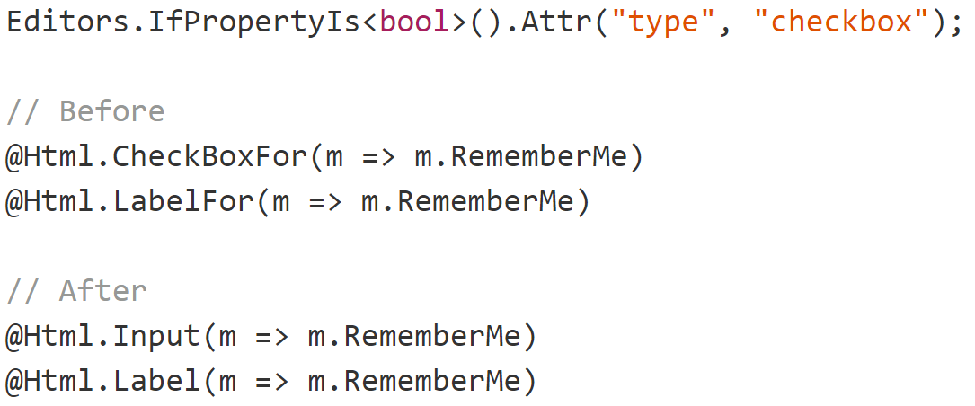
Sensible Defaults (inputs)

Slide 59
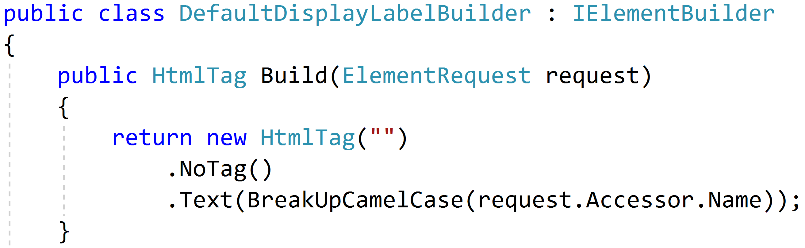
New Primitives (display labels)

Slide 60
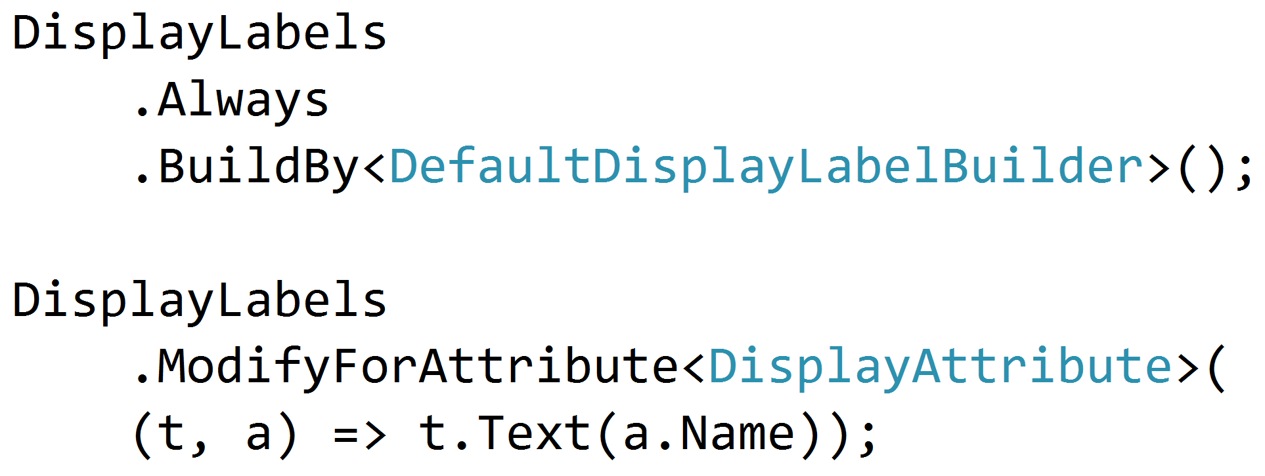
Building Display Labels

Slide 61
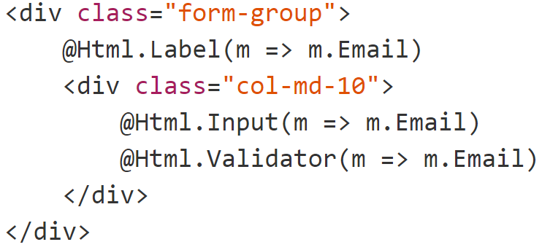
Labels, inputs and validators

Slide 62
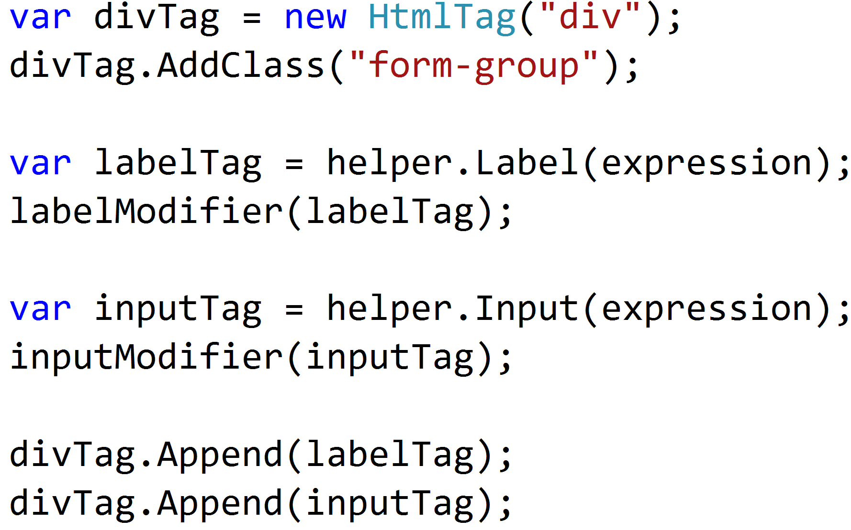
Larger primitives

Slide 63
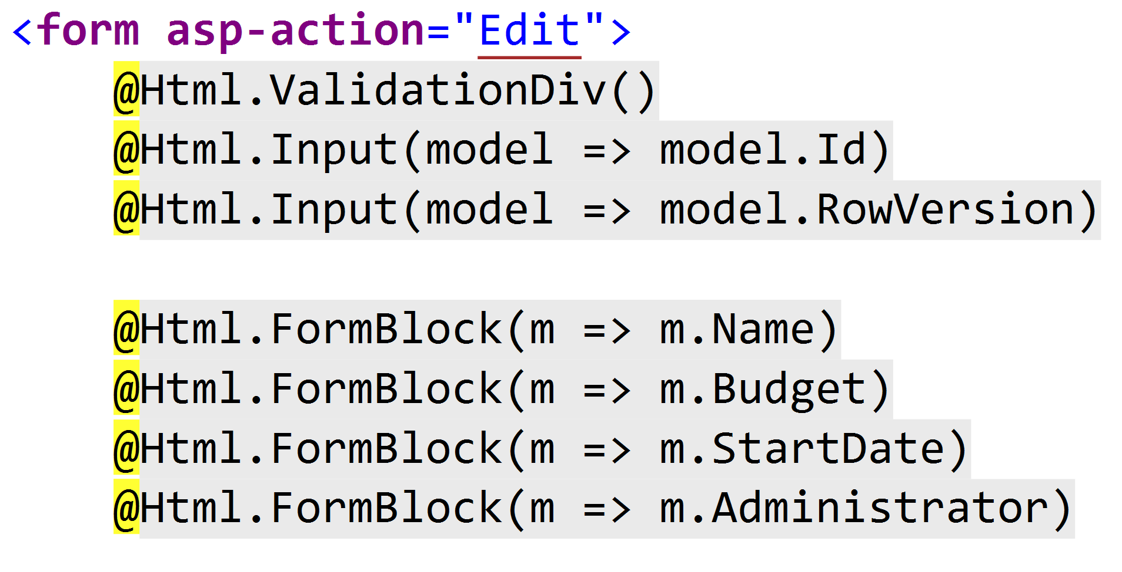
Final form

Slide 64
BUT WAIT I AM USING DURANDGULAREACT
(In which Jimmy gets sad)

Slide 65
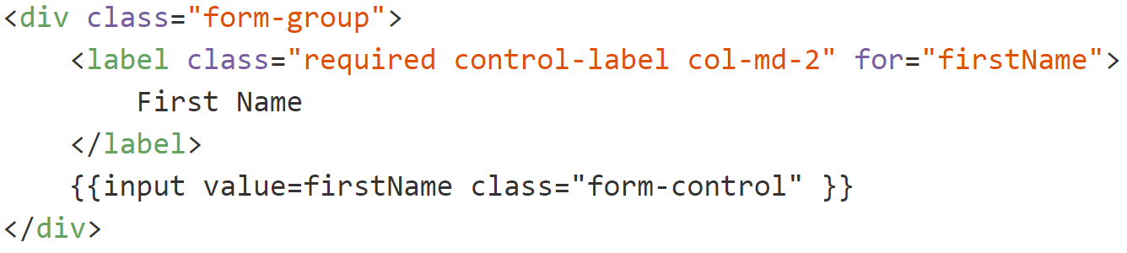
Back to the drawing board…

Slide 66
Problems
Browser
Server
POST
Rendering here
Metadata here
Templates, JS etc

Slide 67
Solution: Angularazor views
Razor View
Server
Razor Parser
Angular Component
Angular Binding
Client
Rendered HTML

Slide 68
Parting thoughts
Conventions = good
Magic = bad
Codegen is the devil

Slide 69
Blowing up the bike shed with conventions
Jimmy Bogard
@jbogard
github.com/jbogard
jimmybogard.com

